Slide 1
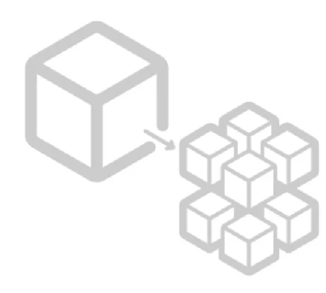
Microservices
Part 4 : Zuul API Gateway

Slide 2
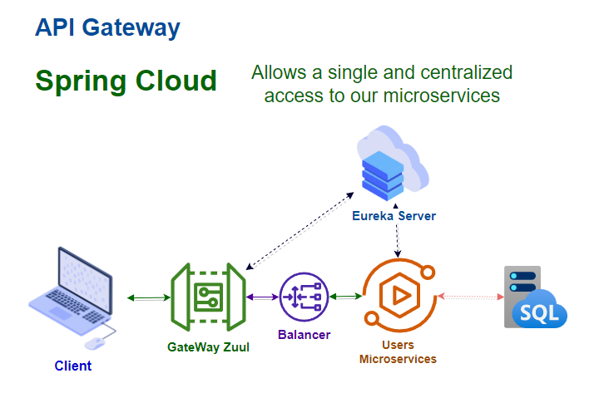
Architecture

Slide 3

Let’s implement our Zuul API Gateway

Slide 4
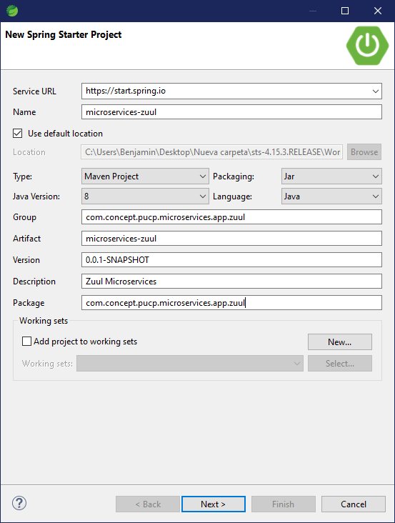
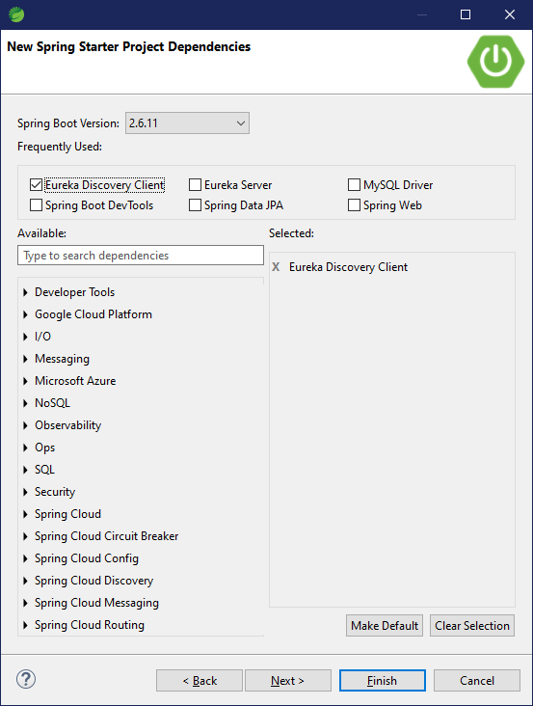
Adding Zuul

Slide 5
Adding Zuul

Slide 6
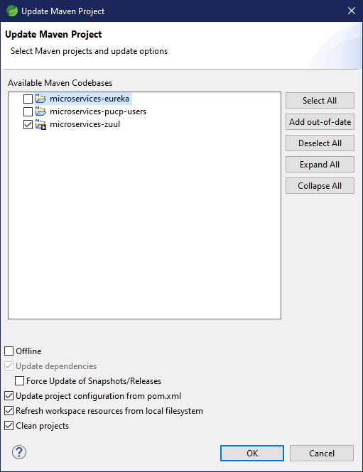
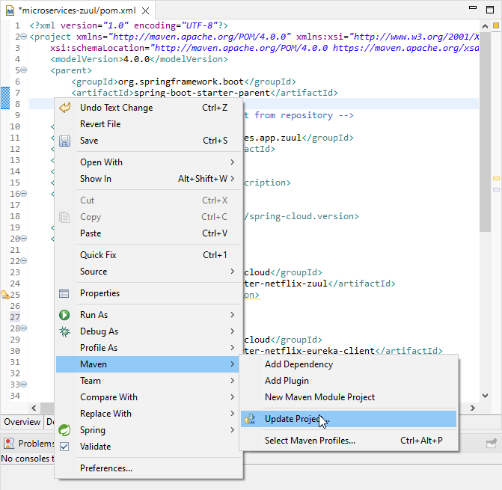
Adding Zuul

Slide 7
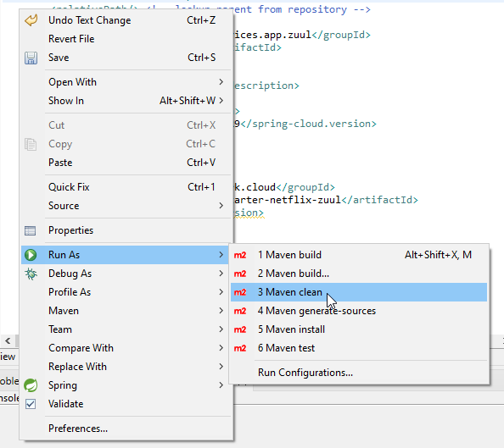
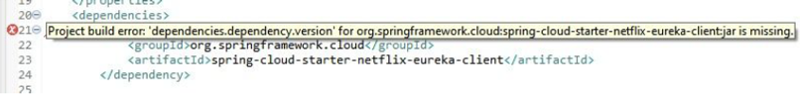
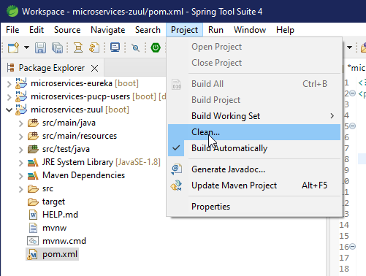
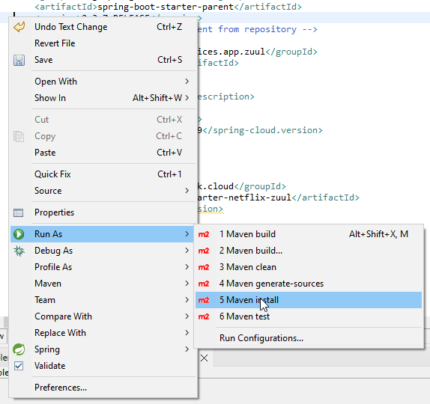
Adding Zuul (Just in case)
- In case the pom shows an error that eureka-client.jar is missing, clean the Project (Project -> Clean...) and restart the IDE
If the problem persists:
- Right click on the project -> Run As... -> Maven Clean
- Right click on the project -> Run As... -> Maven Install

Slide 8
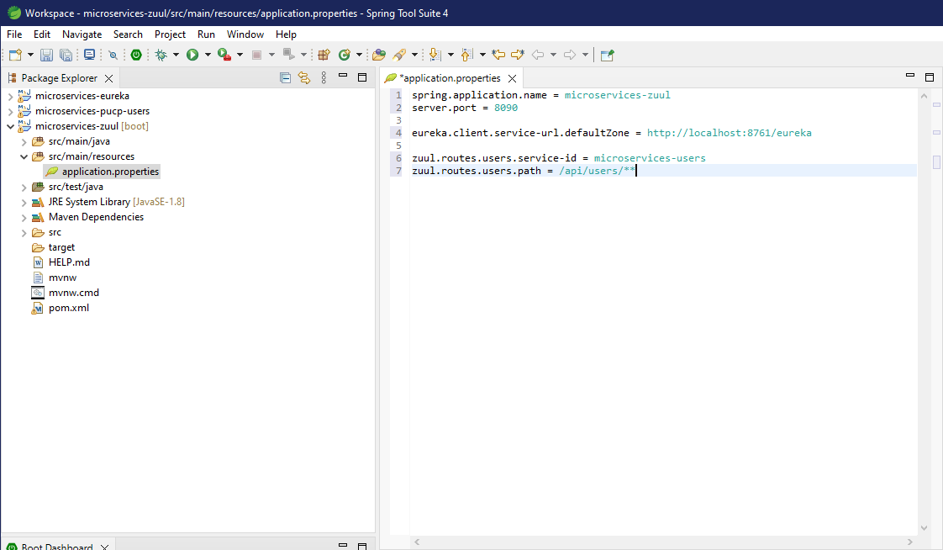
Adding Zuul

Slide 9
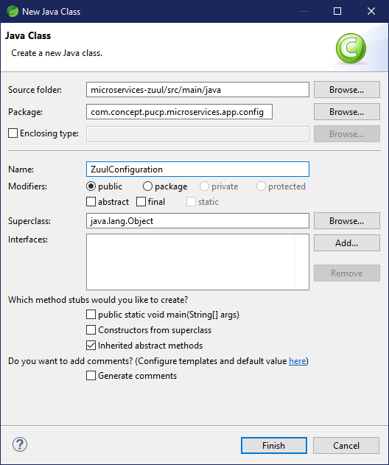
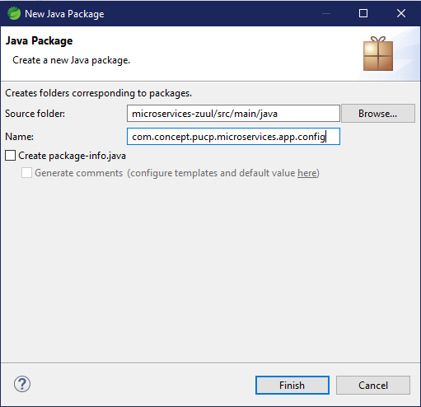
Adding Zuul

Slide 10
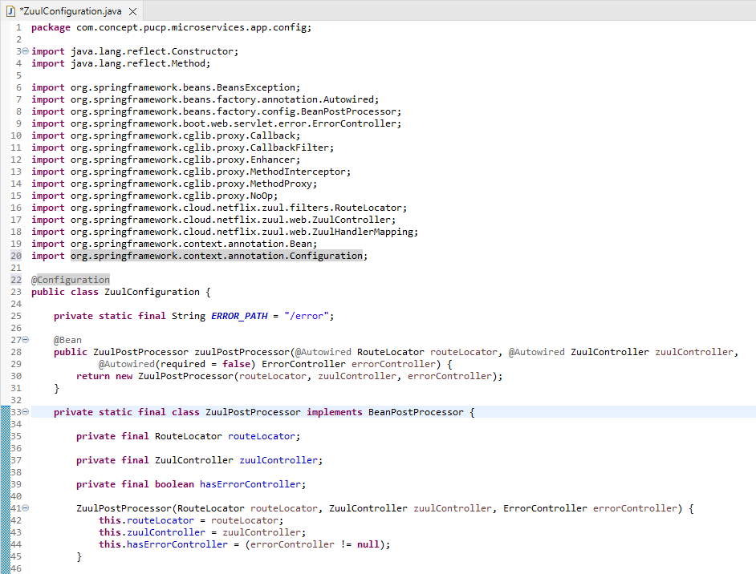
Adding Zuul

Slide 11
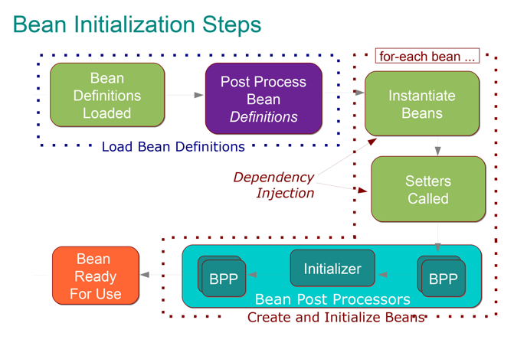
Bean in Spring
Are the objects that form the backbone of the application and which are instantiated, assembled, and managed by a Spring ApplicationContext

Slide 12
Adding Zuul

Slide 13
Adding Zuul

Slide 14
Adding Zuul

Slide 15
Adding Zuul

Slide 16
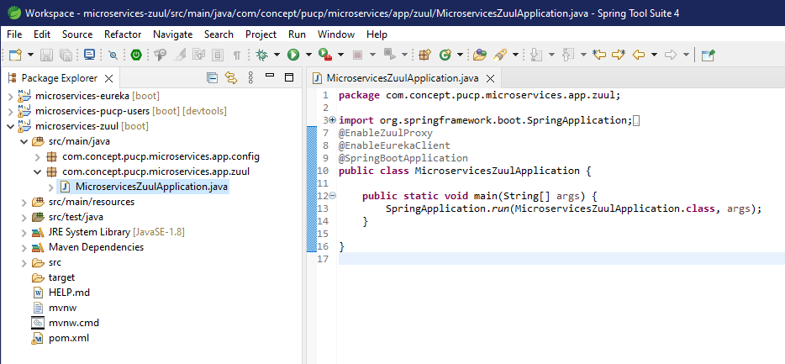
Adding Zuul

Slide 17
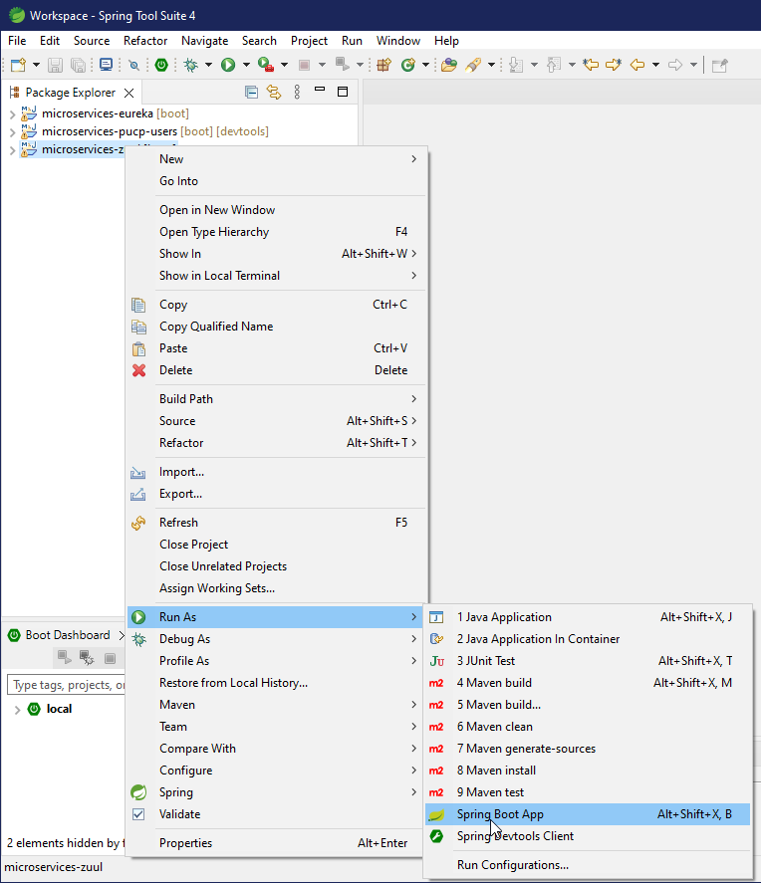
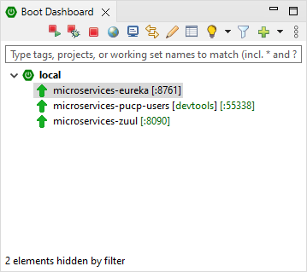
Testing our Project

Slide 18
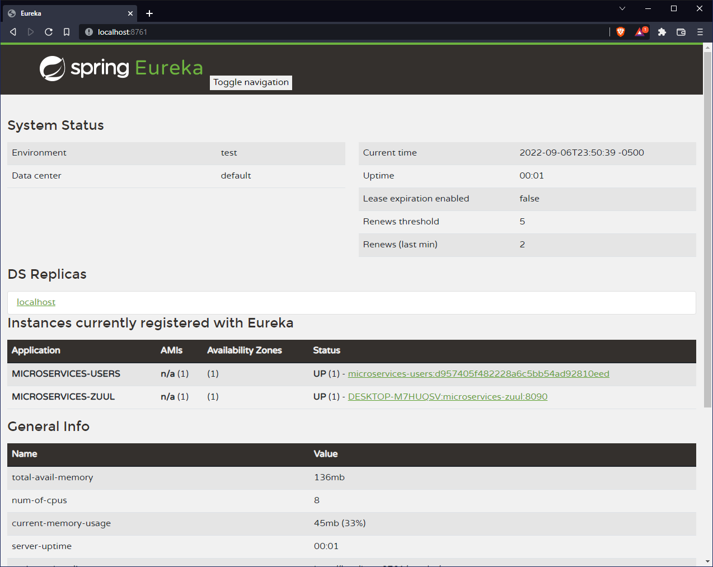
Testing our Project

Slide 19

Testing our Project

Slide 20
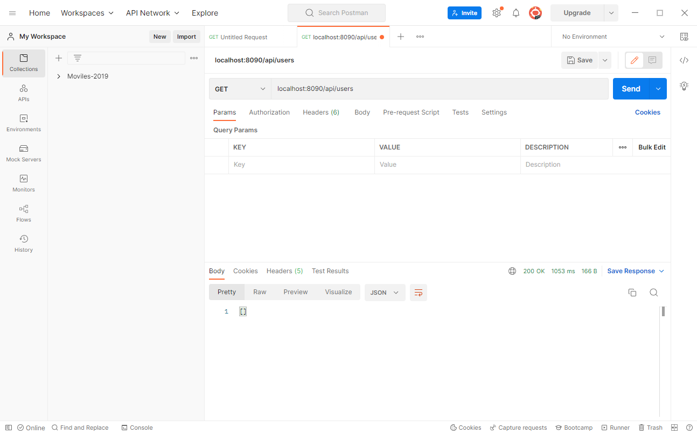
Testing our Project – List

Slide 21
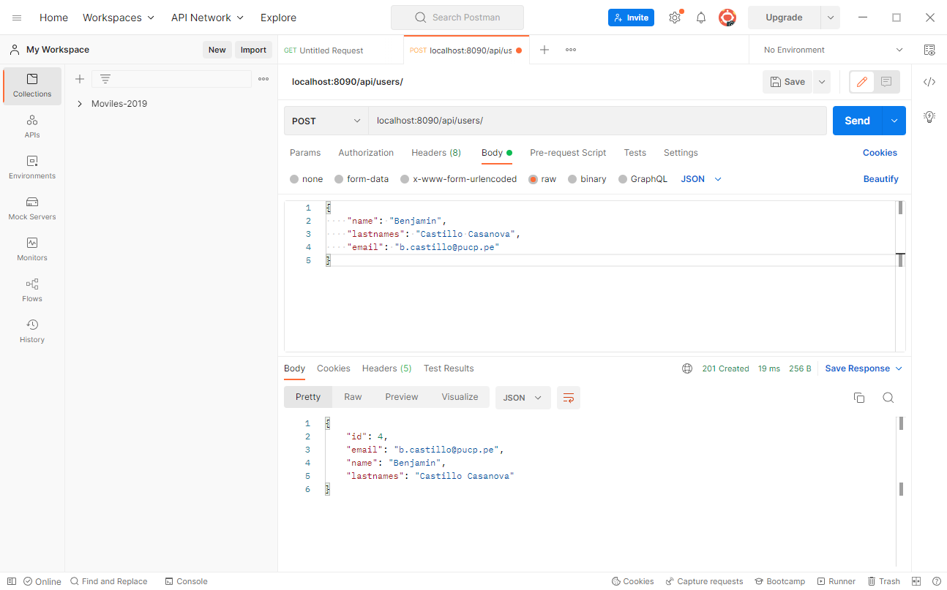
Testing our Project – Create

Slide 22
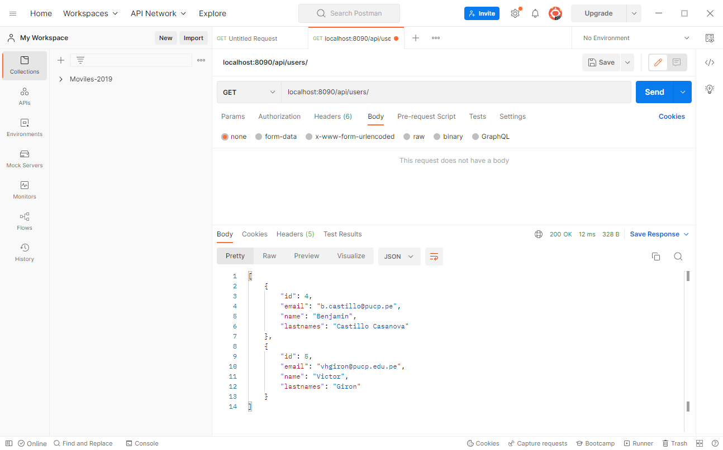
Testing our Project – List Again

Slide 23
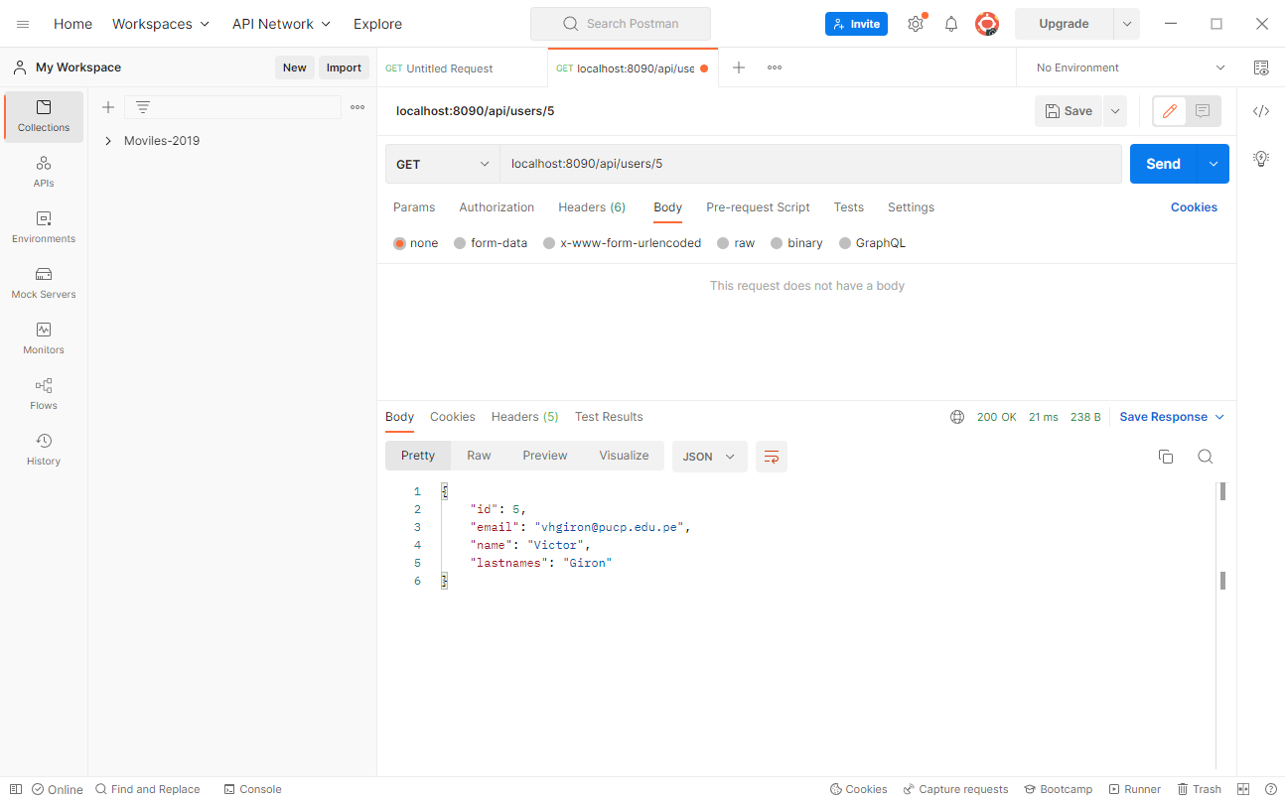
Testing our Project – List by ID

Slide 24
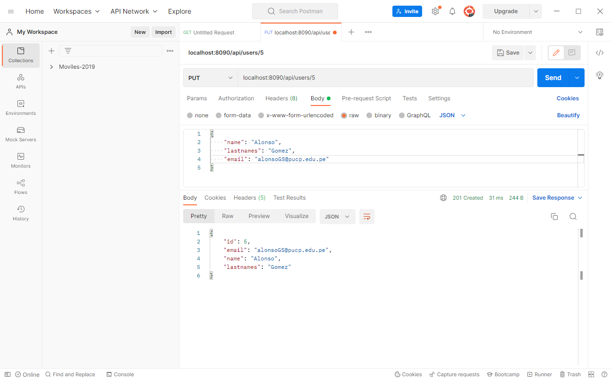
Testing our Project – Modify

Slide 25
Testing our Project – Delete

Slide 26
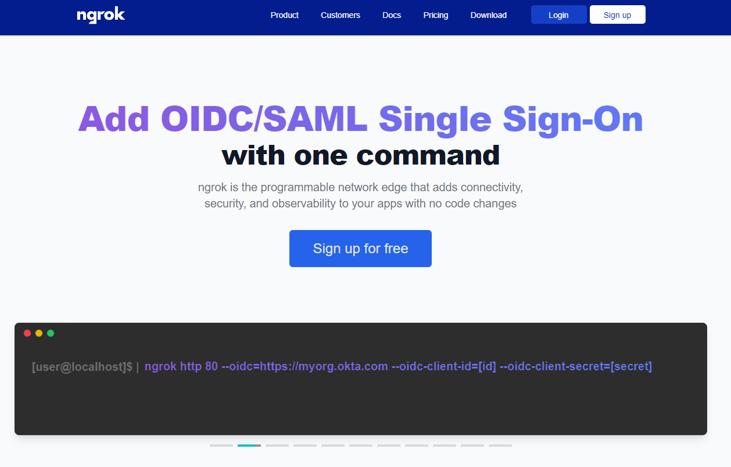
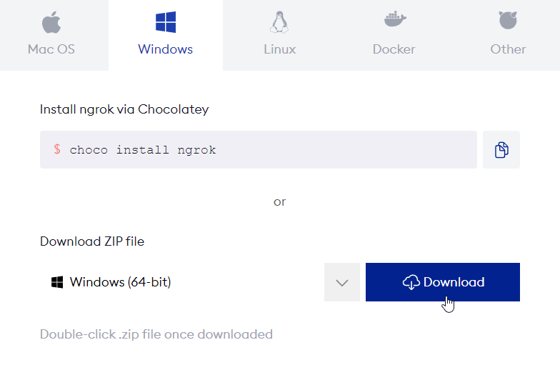
Accesing from another computer
https://ngrok.com/

Slide 27
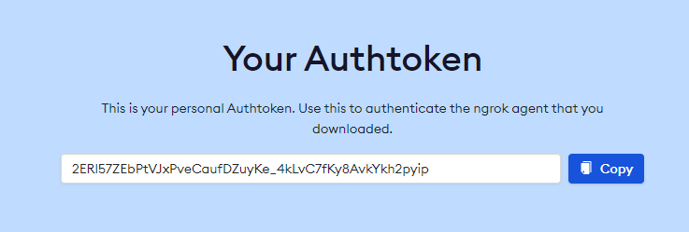
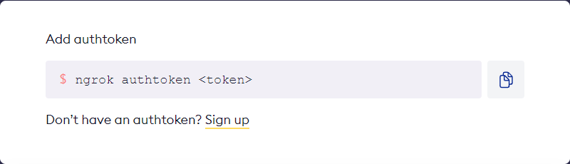
Accesing from another computer

Slide 28
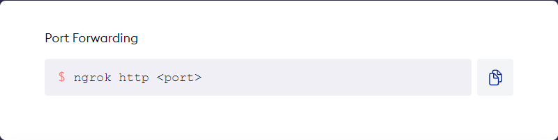
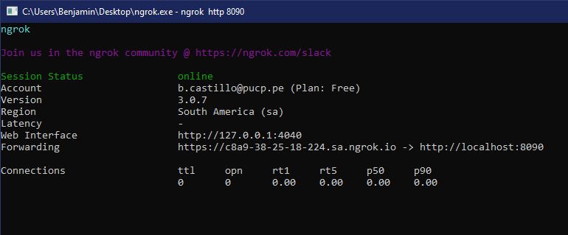
Accesing from another computer

Slide 29

Accesing from another computer

